Slide 1
Human Movement Analysis using wearable technology and AI
Abhishek Singh, Department of Mechanical Engineering, Indian Institute of Technology, Jodhpur
Prof. Philippe C. Dixon, Department of Kinesiology, University of Montreal

Slide 2
Table of contents
01
02
Introduction
Methodology
03
04
Data Processing
Conclusion

Slide 3
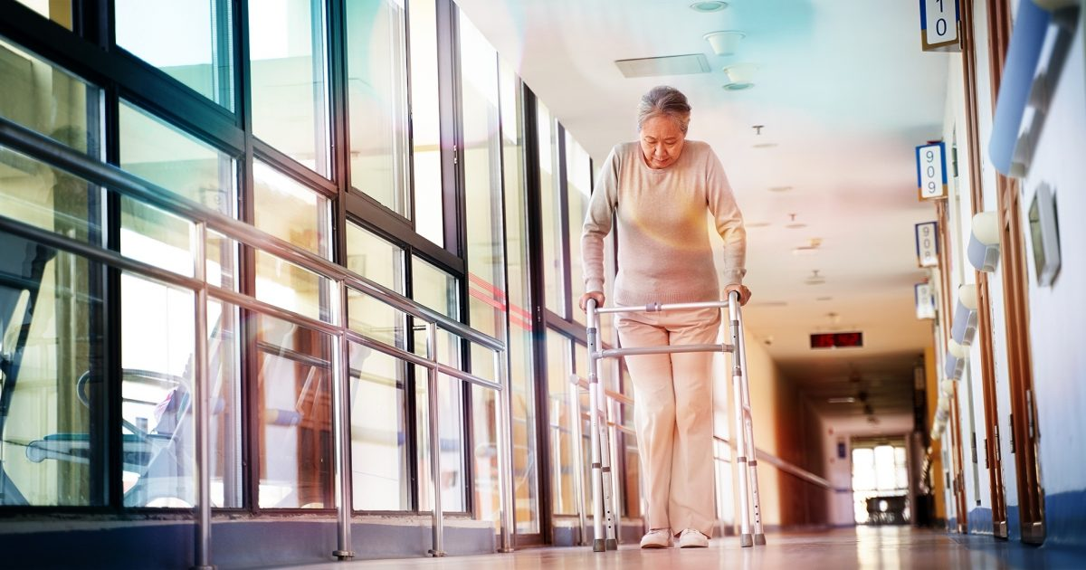
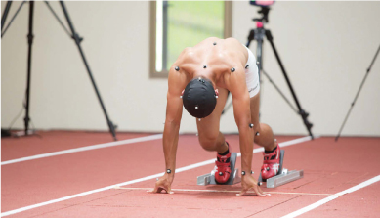
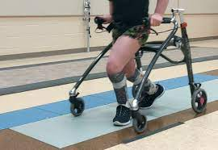
Introduction
Walking is a fundamental feature of human movement allowing individuals to freely explore their environment.
Bipedal locomotion is an inherently unstable activity in which balance control is needed to maintain an upright posture and avoid falls.
Healthcare Sports Rehabilitation
Notes:
Walking is a fundamental feature of human movement allowing individuals to freely explore their environment.
Bipedalism is considered a major evolutionary adaptation that sets humans apart from other primates. The shift from quadrupedalism (walking on all fours) to bipedalism is thought to have occurred over several million years and is associated with the development of tools, increased intelligence, and changes in the environment. Bipedal locomotion is an inherently unstable activity in which balance control is needed to maintain an upright posture and avoid falls. Biomechanics of legs is crucial for a variety of fields, including healthcare, sports science, rehabilitation. It provides a foundation for understanding movement, preventing injuries, enhancing performance, and improving the overall well-being of individuals.

Slide 4
Previous Research
Aging may negatively impact movement smoothness during stair negotiation.
Gait adaptations of older adults on an uneven brick surface can be predicted by age-related physiological changes in strength.
Muscle co-contractions are greater in older adults during walking at self-selected speeds over uneven compared to even surfaces.
Machine learning algorithms can classify outdoor terrain types during running using accelerometry data
Notes:
different age groups exhibit distinct biomechanical responses to the irregular surface.
Machine learning algorithms can classify outdoor terrain types during running using accelerometry data.

Slide 5
Aim
01
02
Gait Biomechanics
Predictive Algorithms
Characterize gait biomechanics over irregular surfaces
Develop predictive algorithms for automatic surface classification

Slide 6
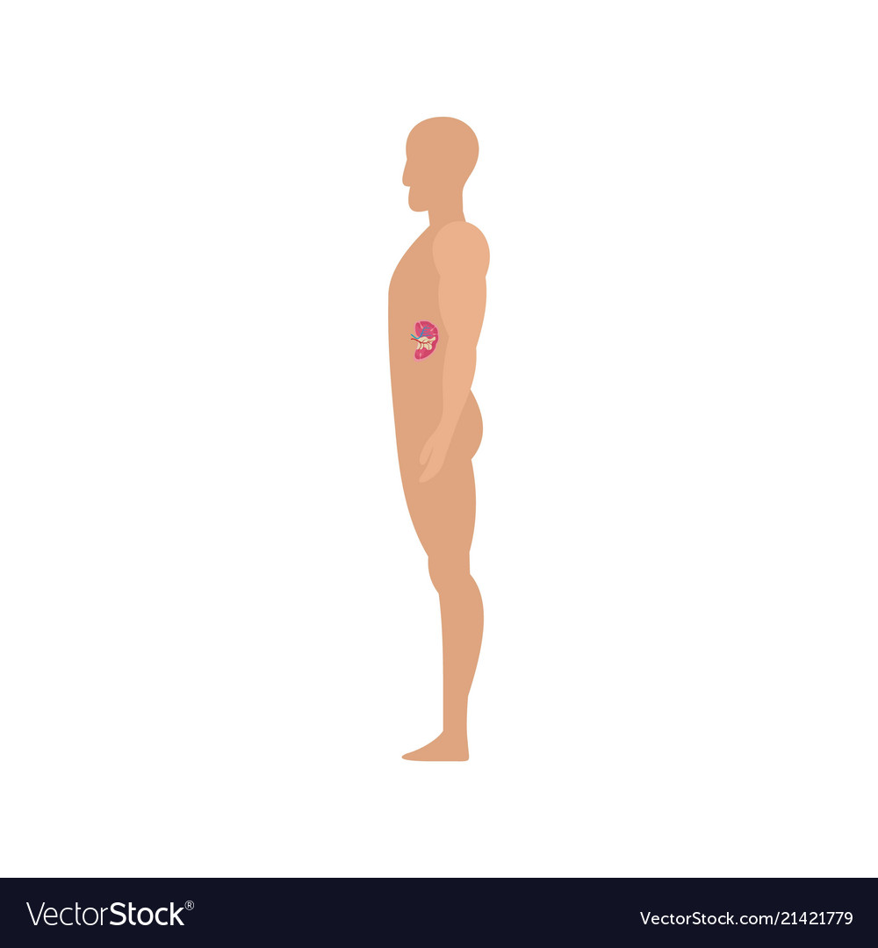
Leg Anatomy
Thigh
Trunk
Leg segment contributes to walking and running
Central body part for housing vital organs
Shank
Foot
Knee-to-ankle segment crucial for weight-bearing
terminal segment for support and locomotion.
Notes:
Foot: Lower limb's terminal segment for support and locomotion.
Shank: Knee-to-ankle segment crucial for weight-bearing.
Thigh: Upper leg segment contributing to walking and running.
Trunk: Central body part with spine, chest, and abdomen housing vital organs.

Slide 7
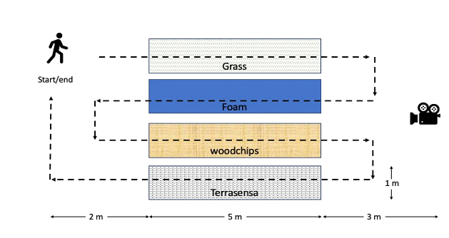
Data Collection
Information
Sensors
Walking
About 176 participant undergo anthropometric measurements
fitting with wireless inertial measurement units (IMUs) and a camera
walking on 5 different surfaces
Notes:
Our Aim is to Quantify the adaptations of body movements when walking on irregular surfaces. For that we selected 5 different surfaces
a) artificial grass (e.g. SoftLawn from SGC Produdcts, Inc.),
(b) foam mat (Giantex),
(c) woodchips (Lignum Group), and
(d) relief floor panel (Terrasensa)
(e) Normal tiles About 176 healthy individuals above the age of 18 year were invited. Participants will undergo anthropometric measurements and. age, gender, weight, leg length were recorded.
This was followed by fitting with wireless inertial measurement units (IMUs) at the low-back, thighs, shanks, and feet.
The chosen Xsens Dot system, known for accuracy, will facilitate gait data collection.
Calibration tasks and self-selected walking on regular and irregular surfaces will follow, aiming to reveal subtle biomechanical adaptations.
Surface order will be randomized, and video cameras synchronized with sensors will streamline data collection.

Slide 8
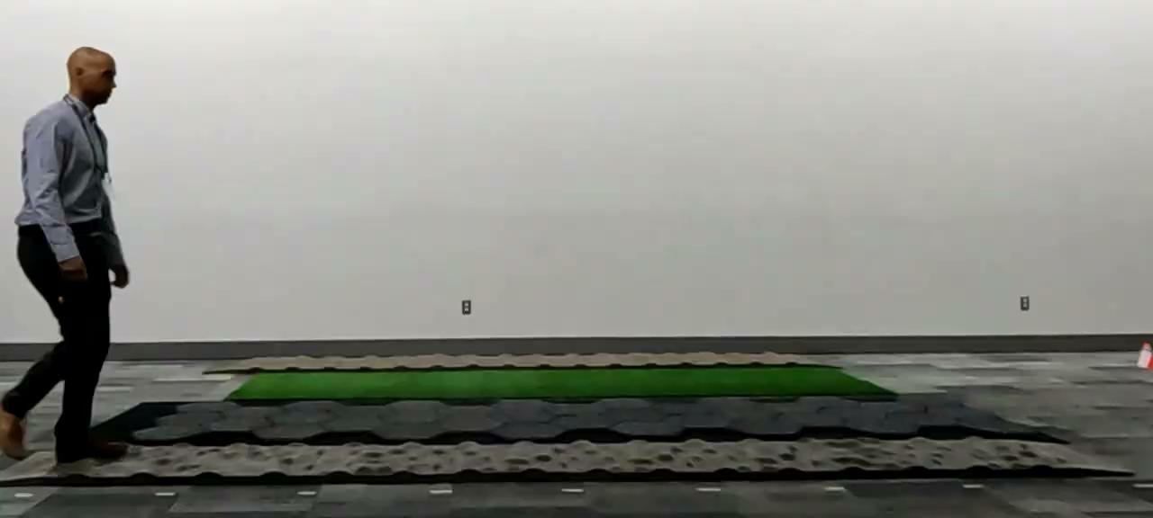

Slide 9
Data Preprocessing
Annotate
Filter
The video was annotated to using MAD_gui
Filtering EMG value using a low pass Butterworth Filter
Detection
Sync
Using matlab, found first heel strike from the IMU data with low peaklim.
The video is synced with the sensors.

Slide 10
Model & Training
Long Short Term Memory Fully Convolutional Network (M-LSTM-FCNs) are DL models specifically designed for classification of time series models.
Multivariate: capture multiple muscles
LSTM: excel at remembering long-term dependencies within each time series
FCN: learn spatial features across different time steps
Notes:
MultivariateLSTM-FCNs, or MLSTM-FCNs, are a type of deep learning model specifically designed for classifying multivariate time series data. They're particularly useful in biomechanics, where you often deal with multiple EMG signals changing over time. Here's a breakdown of their key components:
1. Multivariate:
Unlike traditional LSTM-FCNs built for single time series, MLSTM-FCNs can handle multiple input channels simultaneously. This is crucial for biomechanics, where you might record EMG activity from several muscles at once.
The model processes each channel independently using LSTM cells, capturing individual muscle dynamics.
2. LSTM:
Long Short-Term Memory (LSTM) cells are the backbone of the model. They excel at remembering long-term dependencies within each time series, crucial for understanding how muscle activation patterns evolve throughout a movement cycle.
3. FCN:
Fully Convolutional Networks (FCNs) replace the usual dense layers in LSTMs. This allows the model to learn spatial features across different time steps, understanding how muscle activity spreads or synchronizes across different channels.
4. Squeeze-and-excitation block:
This recent addition helps the model focus on informative parts of the data. It dynamically adjusts the importance of each channel based on its contribution to the overall classification task, potentially reducing noise and improving accuracy.
Benefits of MLSTM-FCNs:
Accuracy: They often outperform traditional models in classifying cyclic biomechanics data like gait patterns or muscle synergies.
Efficiency: The FCN architecture reduces the number of parameters compared to traditional LSTMs, making them faster to train and less prone to overfitting.
Interpretability: Although not always straightforward, the model can offer some insights into which muscle activation patterns contribute most to the classification decision.
Limitations of MLSTM-FCNs:
Computational cost: While more efficient than standard LSTMs, they can still be demanding for large datasets and complex tasks.
Hyperparameter tuning: Finding the right balance between LSTM cells, FCN filters, and other parameters can require experimentation.
Black box nature: While offering some interpretability, the inner workings of the model can be complex and difficult to fully understand.
Overall, MLSTM-FCNs are a powerful tool for classifying multivariate time series data, especially in biomechanics. Their ability to capture long-term dependencies, learn spatial features, and focus on informative parts of the data makes them a strong contender for various biomechanics tasks.

Slide 11
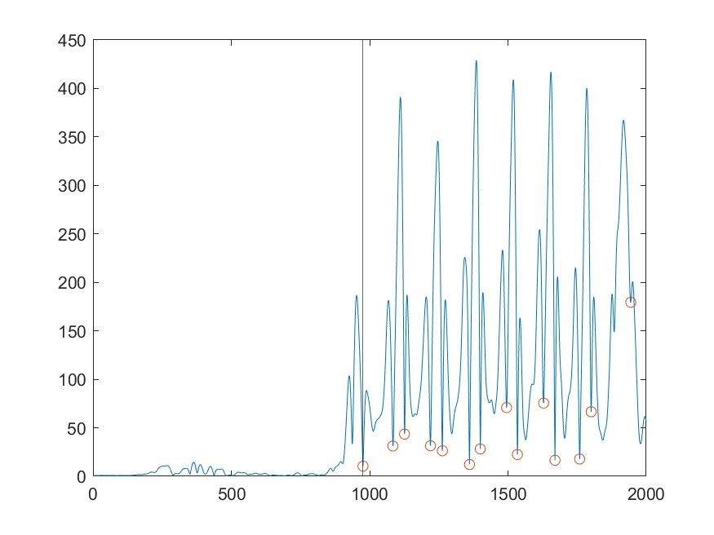
Visual representation of EMG data

Slide 12
Conclusions
Different Surface
Classification model
Found that irregular surfaces has variable EMG value
Multivariate LSTM-FCNs model achieved accuracy of 81%

Slide 13
Thanks
Do you have any questions?
singh.140@iitj.ac.in
+91 9555919751

